Slide 1
Community Policing Division

Slide 3
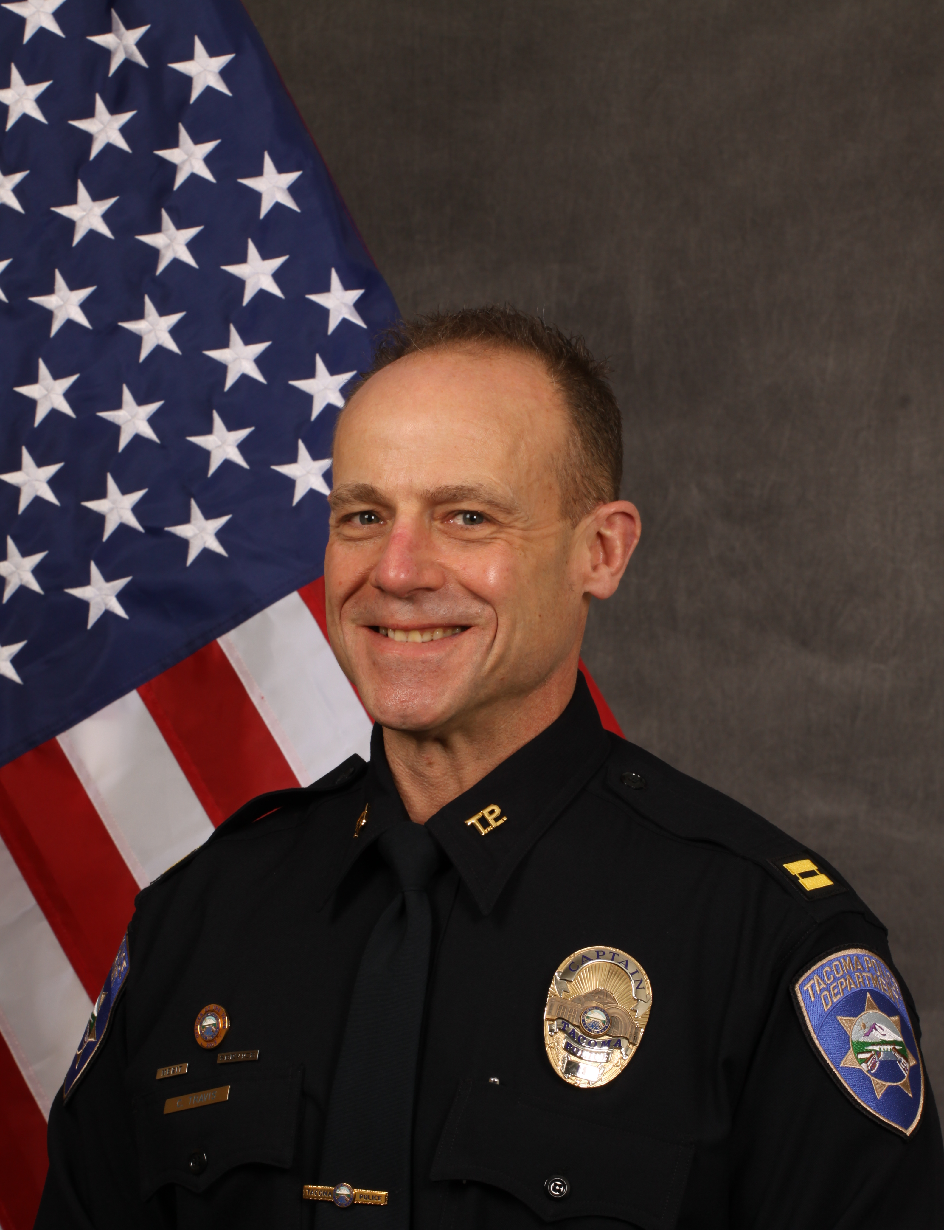
Captain Christopher Travis
Community Policing Division Commander

Slide 4
Community Policing Division
Coordinate proactive policing with citizens
2 Lieutenants (North and South)
1 Administrative Lieutenant
16 Community Liaison Officer Positions (CLO) *
Five Substations (Sectors 1, 2, 3, 4, & NE)
Animal Control Compliance Officers (ACCO)
Homeless Outreach Team (HOT)
Regional Intelligence Group (RIG)
Special Events
Traffic Section

Slide 5
TACOMA Police Sector Map

Slide 6
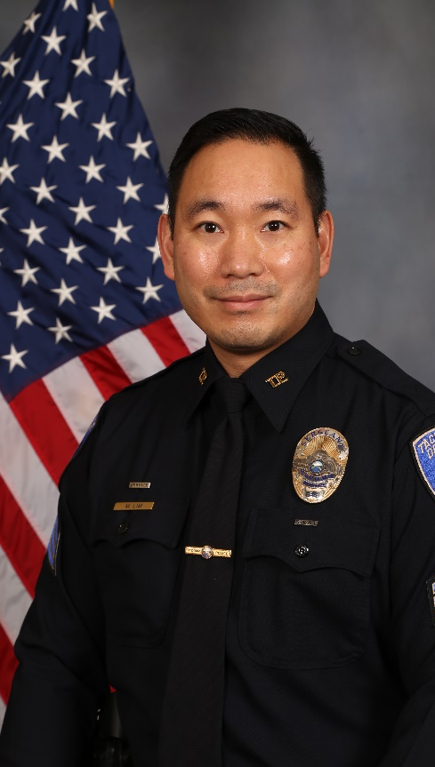
Lieutenant Michael Lim North End
Home to UW Tacoma, Tacoma School District’s School of the Arts, the Tacoma Art Museum, The Glass Museum, and Washington State History Museum
Churches and faith-based organizations helping those in need include: Tacoma Rescue Mission, St. Leo’s, Nativity House, Beacon Center, YWCA, Catholic Community Services, & Tacoma Community House
Several community groups including the HAC, Central Neighborhood Council, New Tacoma Neighborhood Council, & NE Neighborhood Council
Port of Tacoma occupies 2,500 acres in the Tide Flats and is major participant in US International trade. The Northwest Detention Center (Immigrant processing/detention) is also housed there.

Slide 7
North End Tacoma
16 square miles to include miles of waterfront, wooded areas, point defiance park & zoo, ruston way and titlow beach
Large population base with a mixture of residential, commercial and apartments
Numerous business and shopping districts – 6th avenue, point defiance/ruston, old town, pt. Ruston, proctor, stadium and westgate
Home to three hospitals: tacoma general, allenmore, and mary bridge children’s hospital
Seven high schools: bellarmine prep, life christian, foss, silas, stadium, tacoma school of the arts (SOTA), science and math institute (SAMI) as well as tacoma community college, and the university of puget sound
Numerous amenities and public areas: tacoma metro parks, cheney stadium, scott pierson trail, ruston way, old town, live theater, music and performance venues, restaurants, bowling, public markets, seasonal events, art walks, and festivals

Slide 8
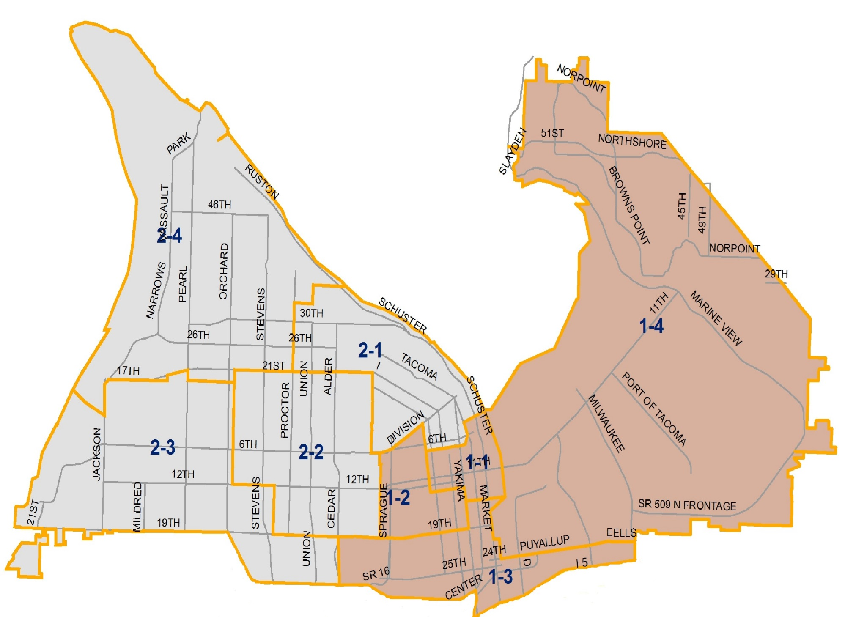
North End

Slide 9
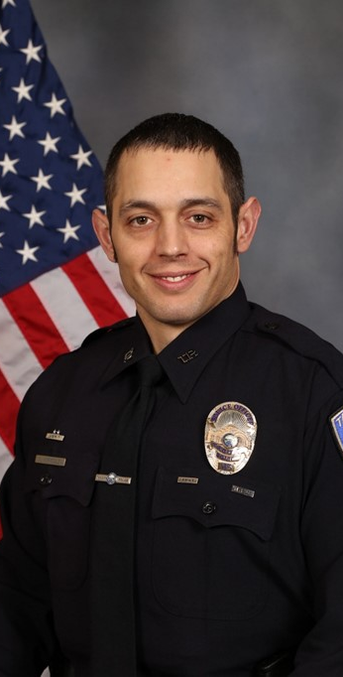
Sergeant Matthew Verkoelen Community Policing North end Sergeant

Slide 10
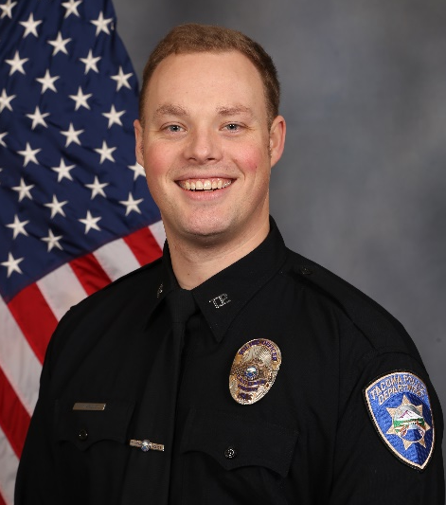
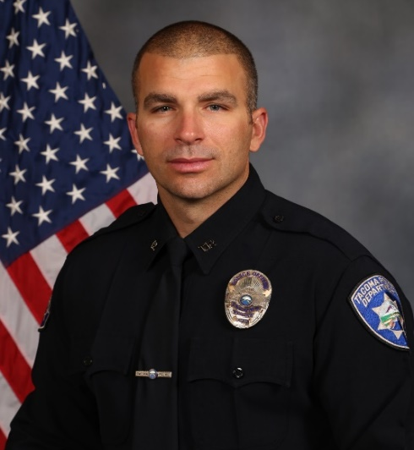
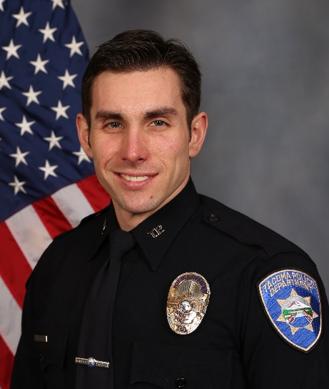
North Community liaison officers Sector one
Officer Trent Dow (1-1)
Downtown Partnership
Officer Andy Guiardinu
Officer Ryan Warner (1-3)
Vacant (1-2)
Vacant (1-4)

Slide 11
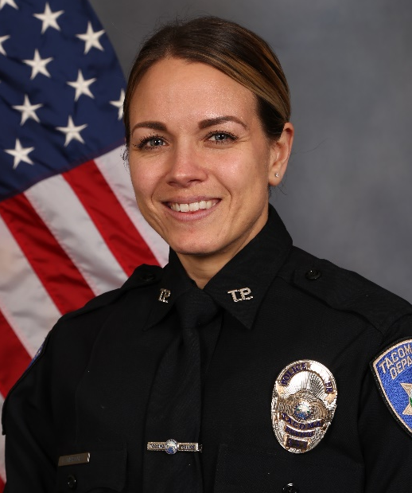
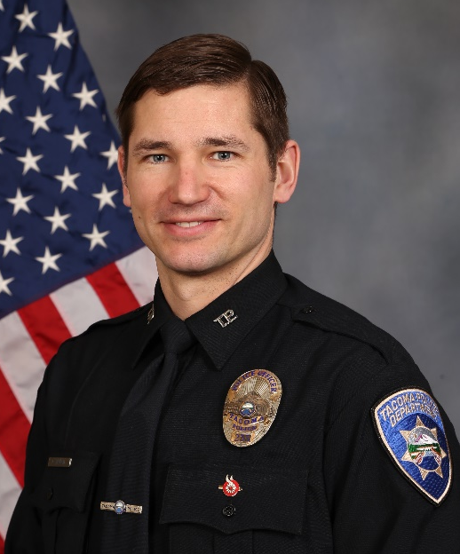
North Community liaison officers Sector tWO
Officer Kristen Braziel (2-1)
Officer Luke Wallin (2-3)
VACANT (2-2)
VACANT (2-4)

Slide 12
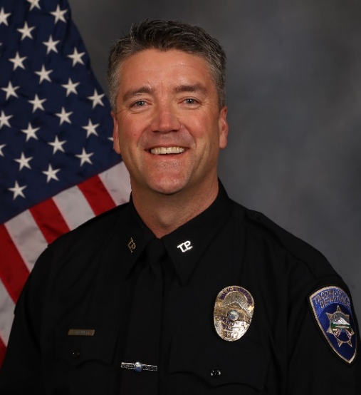
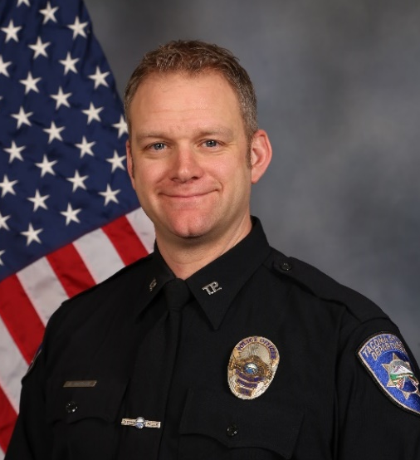
Homeless Engagement Alternatives Liaison
Officer Craig Bennett
Officer Michael McQuade
City Wide HEAL Team
Provide outreach and advocacy balanced with enforcement and action
Identify individuals who may need homeless and mental health services
Aid in assistance and monitoring of scheduled encampment clean-ups
Large encampment cleanups, City sanctioned cleanups
Vehicle habitation issues related to encampments
Attend regular encampment strategy meetings
Address Chronic community issues outside of patrol response
Provides security for Outreach teams

Slide 13
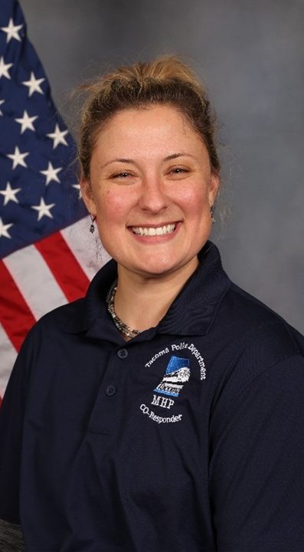
Co-Responder Program DCR Cassie Hallstone
Designed to produce earlier identification and intervention for citizens with mental illness and/or substance use disorder
Create a bridge between law enforcement officers, mental health providers to connect individuals with treatment and resources diverting them from the hospital or jail when possible
Assist Patrol to divert from the ER, Jails. Provide Crisis De-escalation, Assist with Involuntary Detentions, and Voluntary Treatment Options
Notes:
How DCR’s can assist patrol:
Reduce 911 calls
Divert from Hospitals
Reduce taking people who are mild to moderately mentally ill to the Emergency Room
Reduce the amount of time law enforcement spend traveling to the ED
Divert from Jails.
Provide resources and education
Provide all law enforcement with mental health related tools
Provide follow up via phone or email
Complete Mental Health Assessments to address needs of individuals on site
Crisis Intervention/de-escalation
Assist in Voluntary Treatment Options/Resources
Diversion – Divert/Reduce Persons From going to Jail or Hospital
Follow-Up Interactions with Individuals at Risk and/or High Utilizers of services
Involuntary detention – ITA investigation (Involuntary Treatment Act)

Slide 14
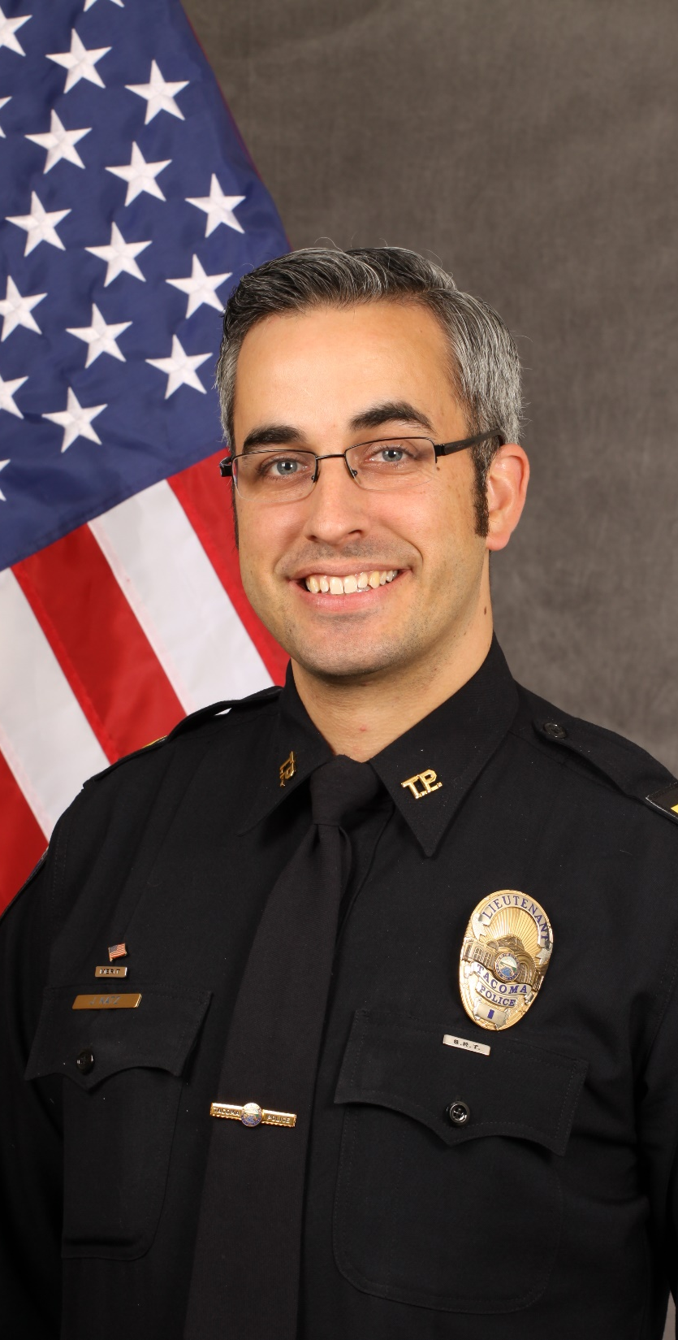
Lieutenant Jeffrey Katz South end
Large retail base to include the Tacoma Mall and South Tacoma Way
Wapato Park (police substation) Meadow Park Golf Course, & the Star Center Boys & Girls Club
South Tacoma Neighborhood Council and numerous Safe Streets groups
Close relationship with our Military partners at Joint Base Lewis-McChord

Slide 15
SOUTH End Tacoma
Approximately 60,000 residents with a diverse array of ethnicities, cultures, and religions from around the world.
Wide range of income and education levels with numerous foreign languages spoken.
Numerous cultural festivals and events throughout the year.
Borders Puyallup Tribal property. Partnership with Puyallup Tribal Police.
Strong partnership with Safe Streets and 31 active community groups.

Slide 16
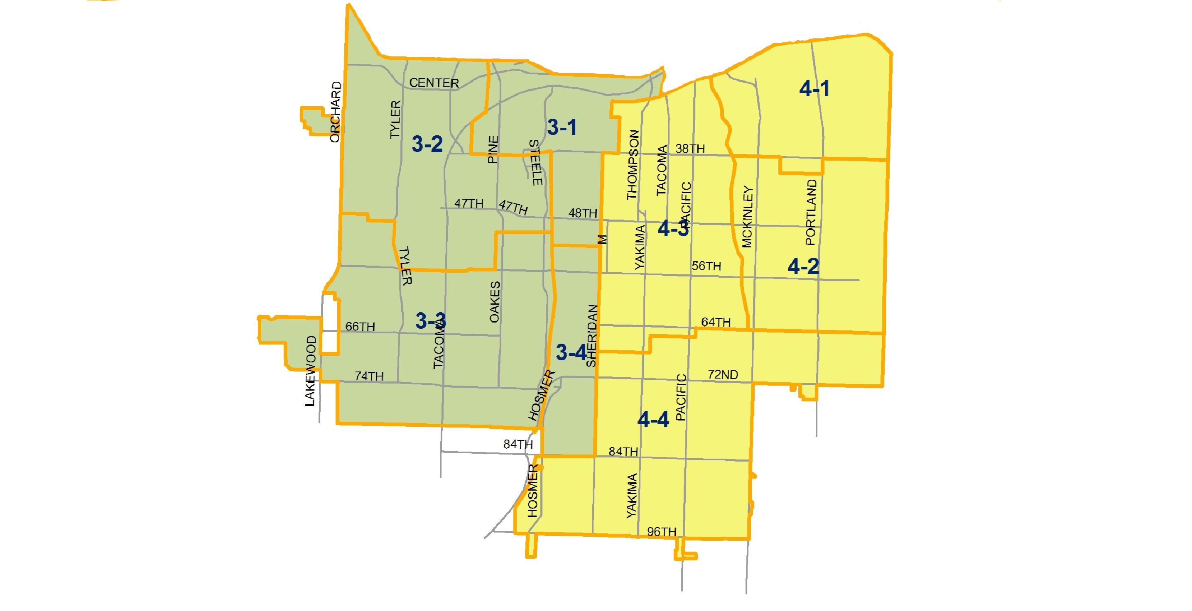
South Tacoma

Slide 17
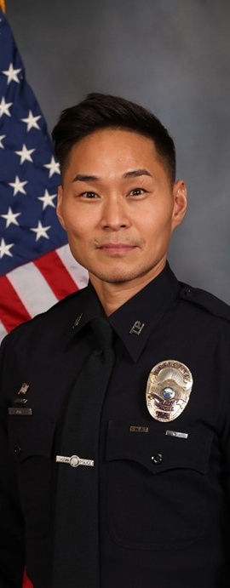
Sergeant Brian Kim Community Policing sOUTH end Sergeant

Slide 18
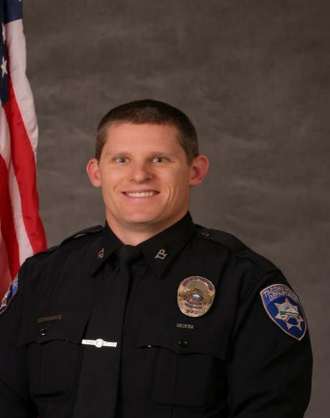
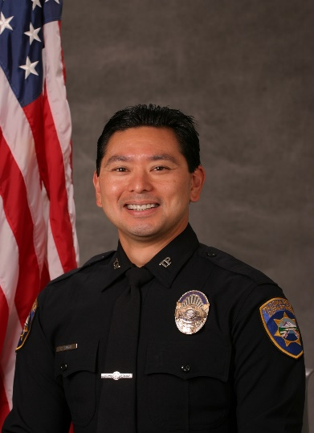
sOUTH Community liaison officers Sector three
Officer Timothy Snyder (3-2)
Officer Craig Sugai (3-4)
VACANT (3-1)
VACANT (3-3)

Slide 19
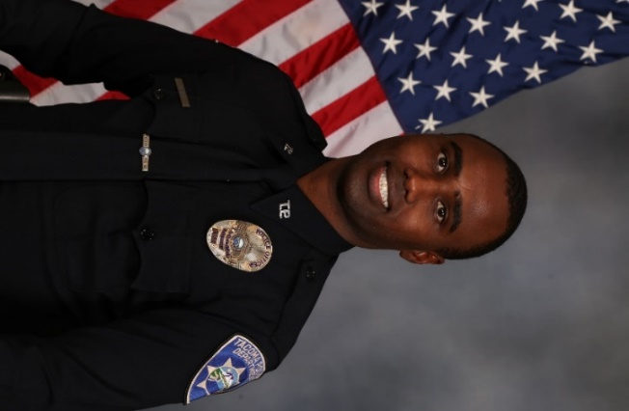
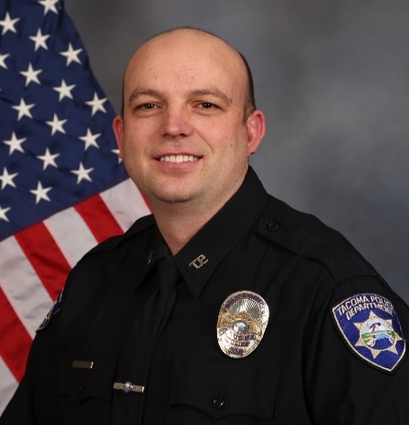
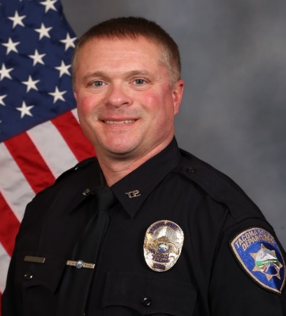
South Community liaison officers Sector four
Officer Mohamud Ali
(4-1)
Officer Steven Butts (4-2)
Officer Max Benboe (4-4)
VACANT (4-3)

Slide 20
Examples of Community Involvement
Proactive involvement with neighborhood criminal and nuisance problems
Partner with neighbors & businesses to share responsibility to resolve crime, blight, etc.
Identifying chronic criminal and nuisance issues and partner with City, State, Federal, Private Agencies, Charities, Businesses, and Citizen Groups to resolve these problems
Assist in coordinating community events (neighborhood clean-ups, community fairs & festivals, school mentoring events & career days, annual National Night Out events, etc.)

Slide 21
Examples of Community Involvement – continued
Assist in coordinating community events (neighborhood clean-ups, community fairs & festivals, school mentoring events & career days, annual National Night Out events, etc.)
Partner with Safe Streets
Partner with 8 Neighborhood Councils
Partner with 15 Business Districts
Partner with numerous Neighborhood Groups

Slide 22
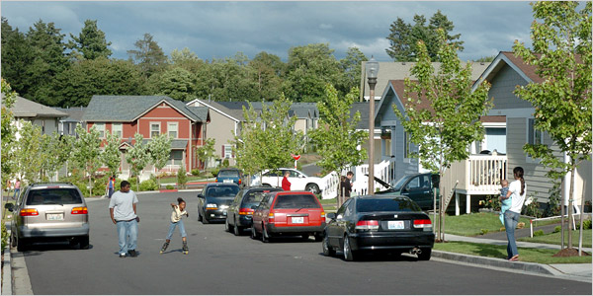
Examples of Community Involvement - continued
Partner with many multi-housing complexes
Partner with Metro Parks
Focus is to improve quality of life

Slide 23
Collaboration with local city, county, state and federal agencies

Slide 24
Neighborhood Councils
Established 8 Councils in 1992
Independent, non-profit citizen organizations
Every Tacoma citizen lives within a Council
Promote citizen-based neighborhood improvements through the Innovative Grant program
Awarded $4,000 each biennium
Advise City Council on local topics
Any resident or business owner can join

Slide 25
Neighborhood Councils

Slide 26
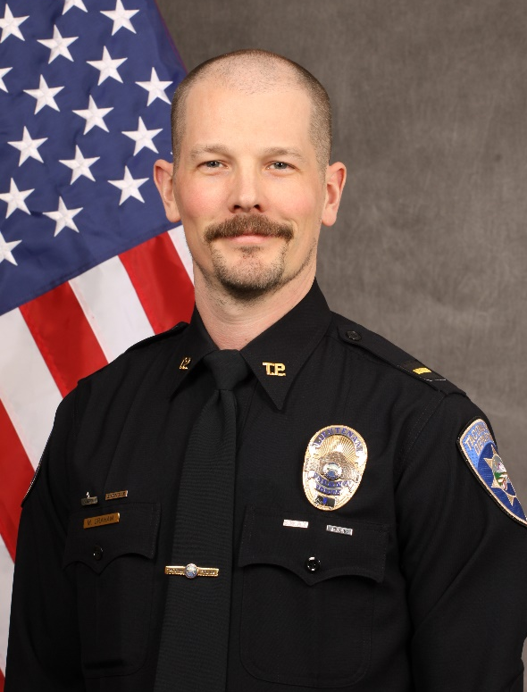
Special Events
Lieutenant
Matt Graham
Sergeant Jason Mills

Slide 27
Special Events Section
Designed for intelligence, facilitation, preparedness, and education
Emergency Preparedness and Response:
For terrorism attack
Natural disasters (law enforcement role)
Train City and Community on what to do if attacked, disaster, disease, etc.
Educate City of Tacoma employees, businesses, and community to report suspicious activity that may be related to terrorism
Chemical, Biological, Radical and Nuclear/Explosive Ordnance Device (CBRN/EOD) detection of nuclear and radiological materials
Emergency Planning and Management
Critical infrastructure
Business protection and planning
Community protection and planning
Public Works coordination
Provide department units and commanders training to better handle events and incidents

Slide 28
Special Events Continued
Event Planning and Management
Coordinate permitting, logistics, and staffing with Tacoma Venues and Events (TVE) and Metro Parks for all events within the City of Tacoma
Coordination, planning, and staffing of off-duty employment within the City of Tacoma as necessary
Supervise major events as needed
Domestic Intelligence Activities, Collectively With Other Agencies
Liaison with local law enforcement agencies and public or private organizations
Funding and grants
Inform the Department of potential gang threats and/or harmful organizations’ activities
Transportation security, mass transit, school transportation, aviation, and maritime transportation
Research on next-generation security technologies

Slide 29
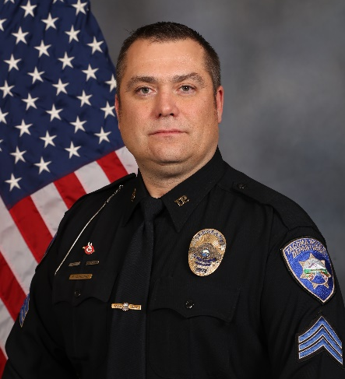
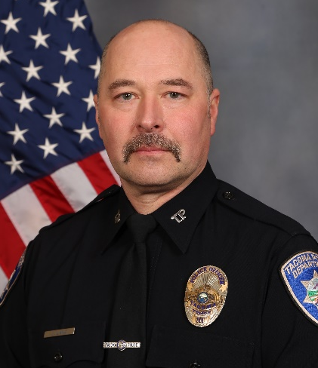
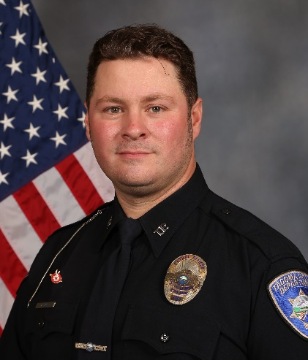
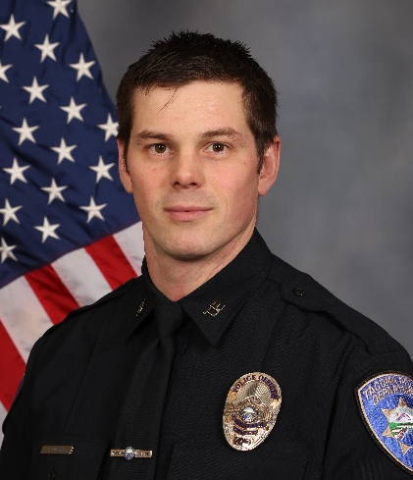
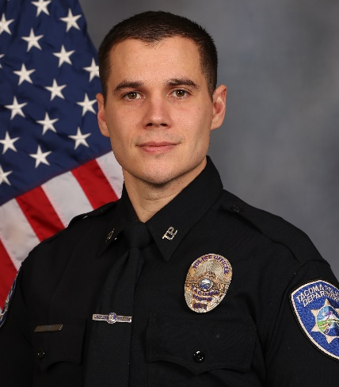
Traffic Unit
Sergeant Sean Darland
Officer Jim Lang
Officer Walter Miller
Four FTE Vacancies
Officer Josh Overly
Officer Jared Levitt

Slide 30
Tacoma Police Department Policy
Educate traffic regulations through programs aimed at identifying specific problems and data driven initiatives
Traffic Safety
Collects collision data within the corporate limits of the City of Tacoma
Forwards road hazard complaints to the Traffic Engineering Department
Work with Traffic Engineering to ensure a safe and effective traffic system in the City
Traffic Engineers assemble data and conduct traffic studies
Enforcement
Uniform enforcement of traffic laws is a basic responsibility of the Police Department
Reduce traffic collisions and injuries
Facilitate the safe and expeditious flow of vehicular and pedestrian traffic
Photo Enforcement
An effort to reduce collisions and improve the safety and flow of local traffic
Program is part of a coordinated, comprehensive approach to traffic enforcement

Slide 31
Parking Enforcement
Primary responsibility through the City’s Parking Enforcement Program
Enforce parking issues downtown and handicap parking violations citywide
DUI Enforcement
Has a comprehensive, on-going, countermeasure program involving education, enforcement, and public support
Traffic Officers to work full-time coordinating and enforcing DUI laws.
Participates in Washington State Traffic Commission on a variety of regional enforcement projects:
DUI Task Force, speed reduction projects and other emphasis projects aimed at increasing safety while driving.
Collision Response
Traffic officers serve as primary investigators for vehicular homicides and assaults
Collisions involving reports of:
Injury, hit & run, drivers suspected of DUI, 1500+ in property damage, hazardous materials, collisions involving disturbances, major traffic congestion, and vehicles blocking the roadway and in need of towing.

Slide 32
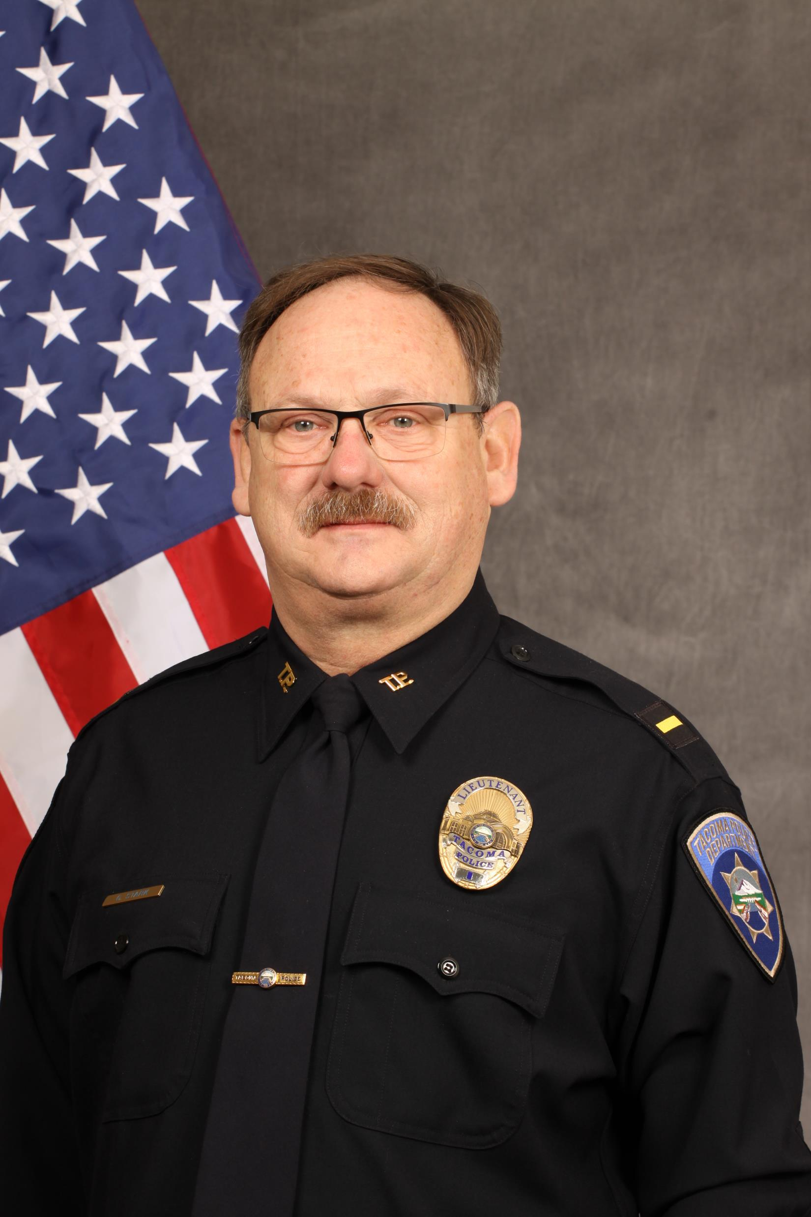
Administrative Lieutenant Gordon Stark Operations bureau
Patrol Asset Management
Specialty equipment accountability for Community Policing and Operations Patrol
Instructor
Procedural Justice course for Entry level and Lateral Officers
Committees/Teams
Member of several departmental, city and county committees and teams
Liaison
Tacoma Public Schools Security
Notes:
(Mental Health Pierce County, Violence Reduction, SS911 Law Enforcement Operational Planning, Radio Regional Steering Group, PEER Support, CIT, DUI/Phlebotomy, BIOHAZARD, Explorers, Search and Rescue, Dive, Youth Outreach Cadre)

Slide 33
Business Districts
City of Tacoma Community and Economic Development
Provide technical assistance to 15 business districts and targeted retail areas
Focus on retail recruitment and mixed-use development through a professional and trained staff
Where there is a cluster of businesses in a walkable neighborhood
Business and property owners may choose to organize to participate in activities that enhance the experience for their customers

Slide 34
Business Districts

Slide 35
Tacoma First 311
For non-emergency requests
Ensures correct City of Tacoma resource are allocated
Access more than 700 frequently asked City-related questions
Tag locations using enhanced mapping
Attach photos of specific problems/requests
Available mobile app for both Apple and Android devices - Download free Tacoma First 311 Mobile App
Tacoma First Customer Support Center
Online Resource
cityoftacoma.org/tacomafirst311
Tacoma First 311 Ask a Question
Telephone Support
Dial 311 within Tacoma City Limits
(253) 591-5000 from anywhere else

Slide 36
Community Cleanup Programs
TacomaFIRST 311
Report illegal dumping, blight, or other environmental concerns
Call-2-Haul Program
Residential customers use up to twice per year at no additional cost
Items can be placed on the curbside for scheduled pickup by Solid Waste crews. Call (253) 502-2100, option 3 to schedule a pickup or visit cityoftacoma.org/call2haul for more information
Customers can also self-haul to the Tacoma Recovery and Transfer Center at no additional cost - but must schedule a self-haul appointment in advance.
Learn More About the Call-2-Haul Program

Slide 37
Community Cleanup Programs
Adopt-a-Spot Neighborhood Litter Patrol
A year-round partnership between the City and neighborhood groups, businesses and residents to help reduce litter and keep public areas clean.
Call (253) 591-5000 or visit cityoftacoma.org/litter for more information
Tacoma Recycle Center - Household Hazardous Waste Facility
Tacoma residents can bring unusable items for free disposal
Accepts many items that may not be accepted for curbside recycling
Residents of Pierce County may use these services free of charge
For more information, call (253) 502-2100 or visit TacomaRecycles.org or cityoftacoma.org/hazwaste
Notes:
The Household Hazardous Waste Facility accepts hazardous materials for safe and responsible disposal.

Slide 38
Community Cleanup Programs
Residential Curbside Glass Recycling
Tacoma residents can recycle glass bottles, jars & household batteries at the City's five drop-off locations
Some locations accept cardboard and scrap metal. Locations, hours, and what is accepted, call (253) 502-2100 or visit Tacoma Recycles Glass
Purple Bag Program
Provides regular waste pickups at select homeless encampments
Intended to limit the harmful impacts to human health and our environment
temporary solution aimed at helping individuals maintain safe and clean-living areas
If a purple bag is found outside of a designated drop-off location, please contact TacomaFIRST 311 and a pickup will be scheduled
Notes:
Purple Bag is a temporary solution until they are able to connect with shelters or other housing opportunities.

Slide 39
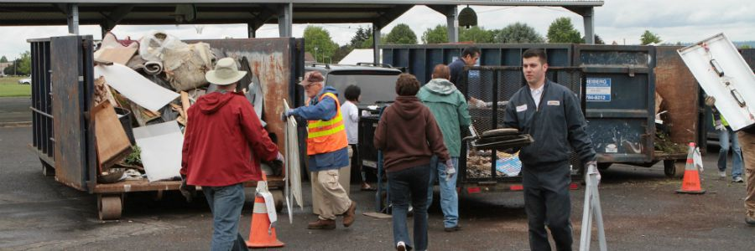
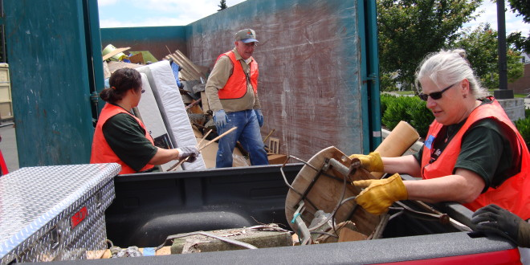

Slide 40
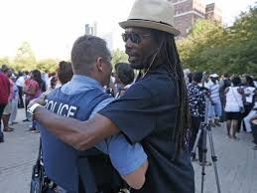
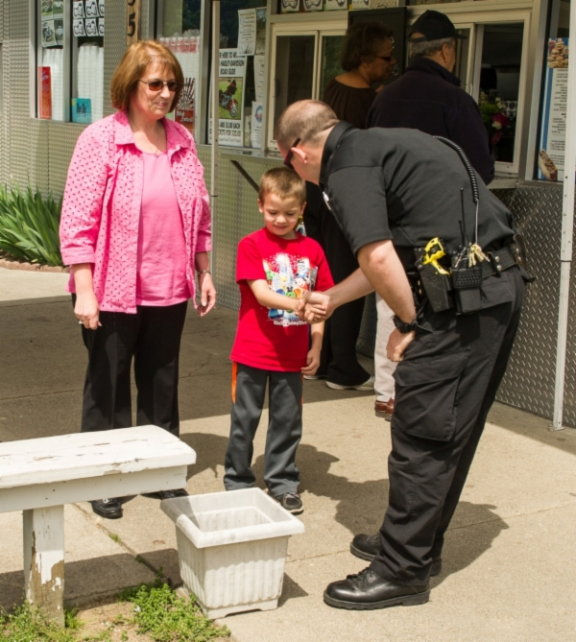
Thank you
QUESTIONS?

Slide 41
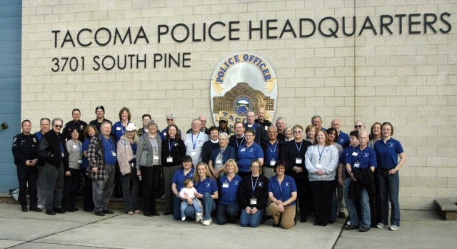
The Tacoma Police Department’s Volunteer Program was designed to:
Provide support, supplemental, and crime prevention service
Enhance law enforcement & community relations by developing a spirit of partnership
Serve as the Department’s ambassadors to the community and provide valuable feedback to the Command Staff.
The program was suspended during Covid and on hold as the City is developing alternate responses and Community Service Program
Notes:
Community Service Officer Program. To be staffed at substations.

